Slide 1

Literature Survey Seminar on Vintage Autoparts – Antique Automotive Parts
Presented By
Gaurav Shripad
Aditya Wadgaonkar
Akash Verma
Pankaj Bankar
Guided By
Mrs. Sonam Chopade
Department of Computer Science & Engineering
S. B. JAIN INSTITUTE OF TECHNOLOGY MANAGEMENT AND RESEARCH,NAGPUR
An Autonomous Institute, Affiliated to RTMNU, Nagpur

Slide 2
Contents
Problem Statement & Objectives
Introduction
Literature Survey
System Design
Proposed Work
Technology to be Use
Advantages & Applications
Plan of Work
References
2
S. B. Jain Institute of Technology Management and Research

Slide 3
Problem Statement & Objectives
Problem Statement
Online Automobile parts Store is a web development project in which customer can easily access the website for automobile parts which are difficult to obtain.
Objectives
To Reduce affords of Customer.
To Provide full satisfaction to user.
3
S. B. Jain Institute of Technology Management and Research

Slide 4
Introduction
In today’s day to day life purchasing of products by visiting stores has become a tough job. As in the modern world going to shop and searching for the product has become difficult for customers. To overcome these difficulties, we are coming up with a website name VAp( Vintage Autoparts).VAp is an Auto parts website which helps to choose a wide range of products through your desktop or smartphone rather than visiting the outlets.
S. B. Jain Institute of Technology Management and Research
4

Slide 5
Literature Survey
Websites / Paper / Article | Reviews / Findings
1. www.bigcommerce.com | The online automotive parts and accessories sales industry has skyrocketed over the past five years as brick-and-mortar retailers enter the online space. According to Statista, this trend will only grow, as the online automotive aftermarket market size is set to nearly triple worldwide by 2027.
2. www.bytestechnolab.com | the auto parts warehouse website for your business and provide your customers a seamless and attractive website with an easy, user-friendly interface to deliver a robust user experience that would enhance conversion rate rather than bounces. Another benefit of building your business with an automotive e-commerce solution online would allow thousands of potential customers to reach you quickly. With such a website, you can easily provide your customers searching online for the products they need by utilizing and practicing good E-commerce SEO for auto parts

Slide 6
Real-Time Survey | Reviews / Findings
1. Bombay Scooter agency | location – Yashwant stadium ,Sitaburdi, Nagpur By Survey in shop we find out that, Some parts like, Engine(includes piston, block piston, piston ring etc.), Clutch(includes Clutch half, clutch center block set etc.), Are required on daily purpose where as it quantity low, and customer have to wait for 2 to 4 days to get these parts.
2. Karan enterprises | location – Katol Naka , Nagpur 1. By Survey in shop we find out that, Customer always ask for parts like, Oil Tube, Oil tank assembly ,sensor assembly ,Transmission Extension ,Transmission oil RHD 4WD ,pedal & brackets ,element filter etc. 2. Customer also ask for Custom parts like silencer, Custom lights,Air horns, etc.
3. Bharat Scooter Service | Location - Agresen Square gandhibaug 1. By Survey in shop we find out that, Some parts like, Engine(includes piston, block piston, piston ring etc.), Clutch(includes Clutch half, clutch center block set etc.), Oil tank Parts(includes Oil Seal, Oil pump, Oil Filter etc.)Are required on daily purpose where as it quantity low,and customer have to wait for 2 to 4 days to get these parts.

Slide 7
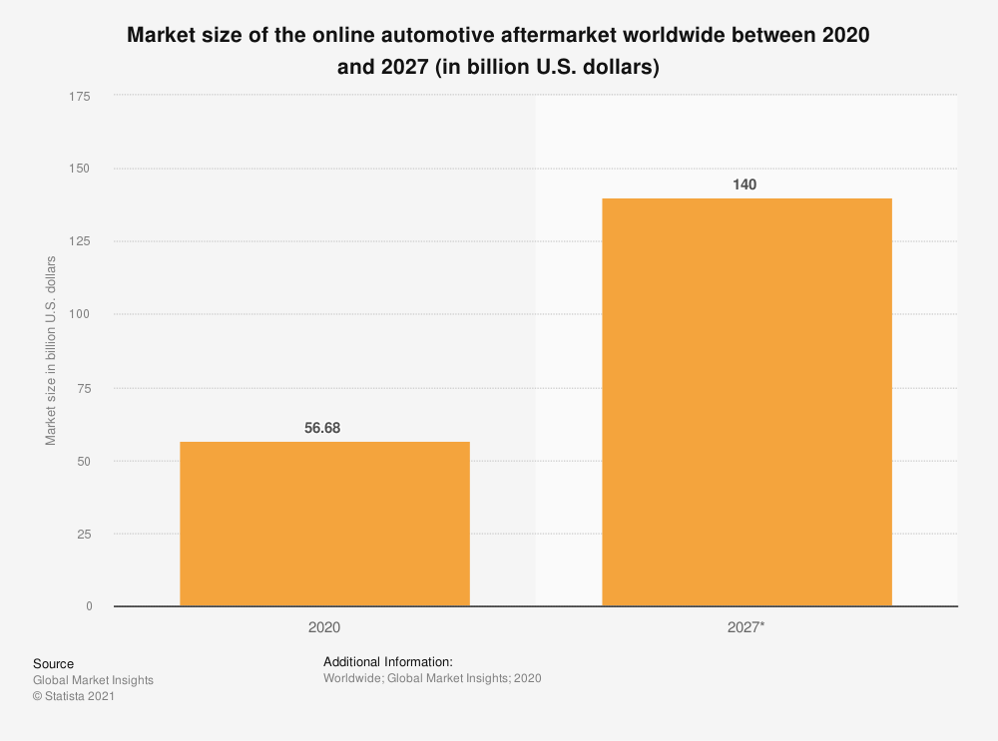
Literature Survey
Survey from bigcommerce.com
The online automotive parts and accessories sales industry has skyrocketed over the past five years as brick-and-mortar retailers enter the online space.
According to Statista, this trend will only grow, as the online automotive aftermarket market size is set to nearly triple worldwide by 2027.
S. B. Jain Institute of Technology Management and research
7

Slide 8
Real Time Survey
Bombay Scooter agency -
location – Yashwant stadium ,Sitaburdi, Nagpur
1. By Survey in shop we find out that, Some parts like, Engine(includes piston, block piston, piston ring etc.),
Clutch(includes Clutch half, clutch center block set etc.),
Body parts(includes indicator, headlights assembly, wirings etc.)
Are required on daily purpose where as it quantity low,
and customer have to wait for 2 to 4 days to get these parts.
S. B. Jain Institute of Technology Management and research
8

Slide 9
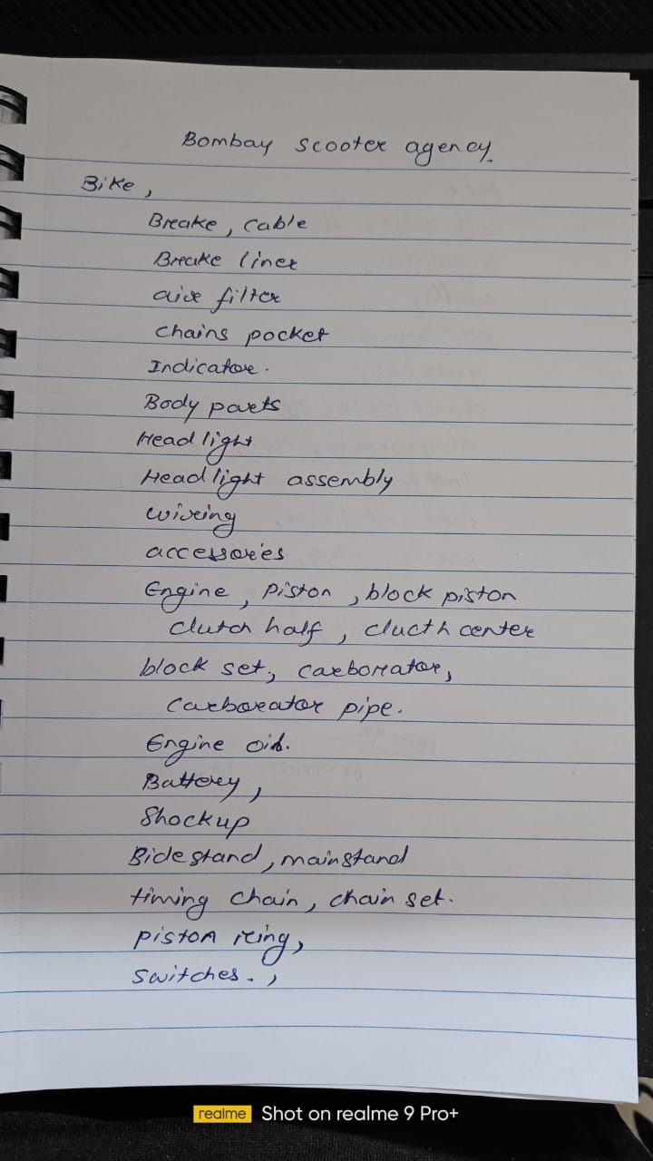
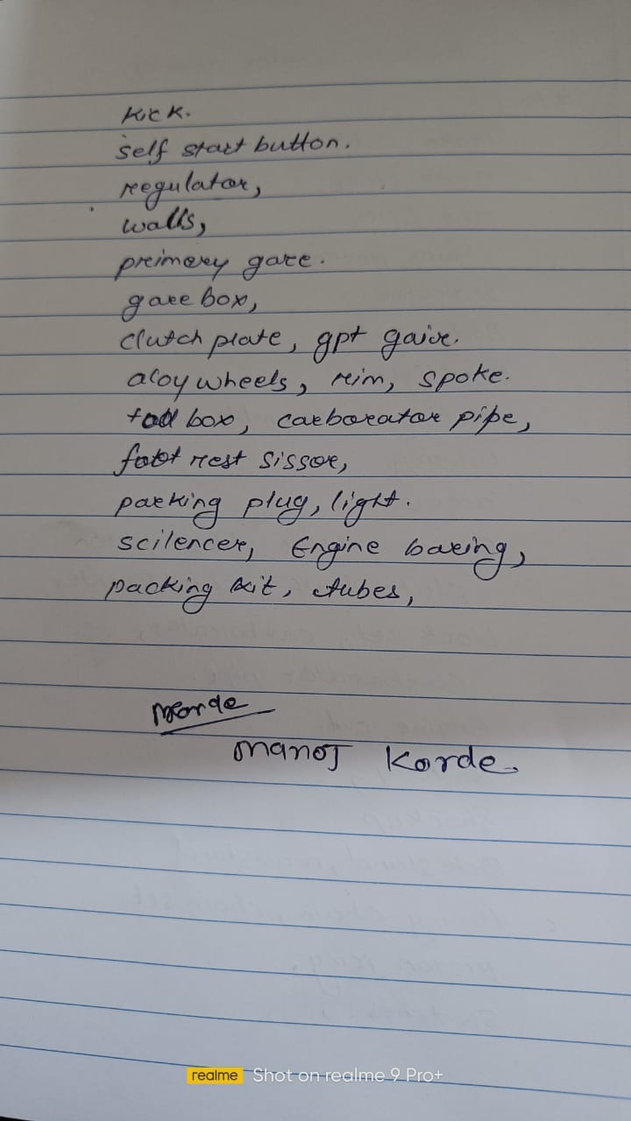

Slide 10
Karan enterprises
location – Katol Naka , Nagpur
1. By Survey in shop we find out that,
Customer always ask for parts like, Oil Tube, Oil tank assembly ,sensor assembly ,Transmission Extension ,Transmission oil RHD 4WD ,pedal & brackets ,element filter etc.
2. Customer also ask for Custom parts like silencer, Custom lights,
Air horns, etc.

Slide 11
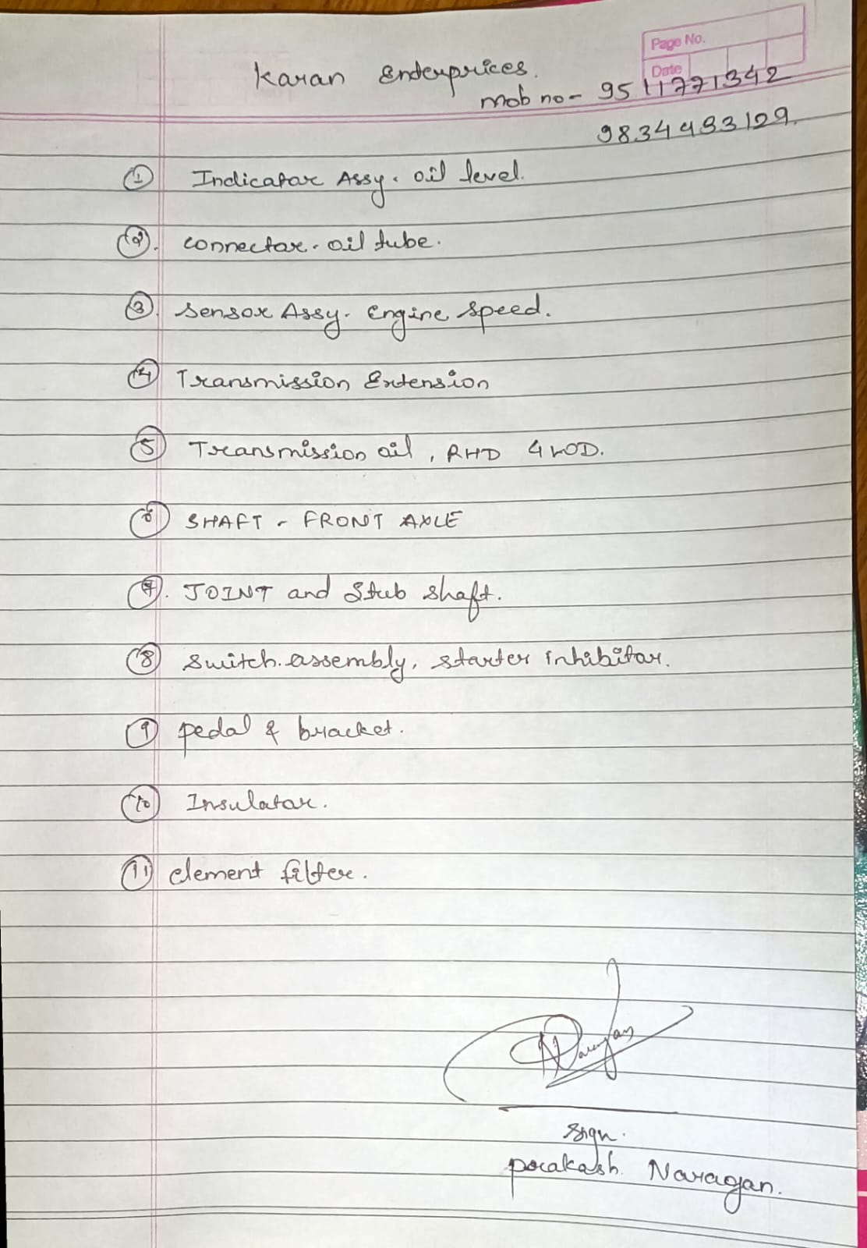

Slide 12
Bharat Scooter Service
Location - Agresen Square gandhibaug
1. By Survey in shop we find out that, Some parts like, Engine(includes piston, block piston, piston ring etc.),
Clutch(includes Clutch half, clutch center block set etc.),
Oil tank Parts(includes Oil Seal, Oil pump, Oil Filter etc.)
Are required on daily purpose where as it quantity low,
and customer have to wait for 2 to 4 days to get these parts.
2.Where as parts like Piston Ring, Cylinders seal, Gears shaft, Oil pump etc. are difficult to get.

Slide 13
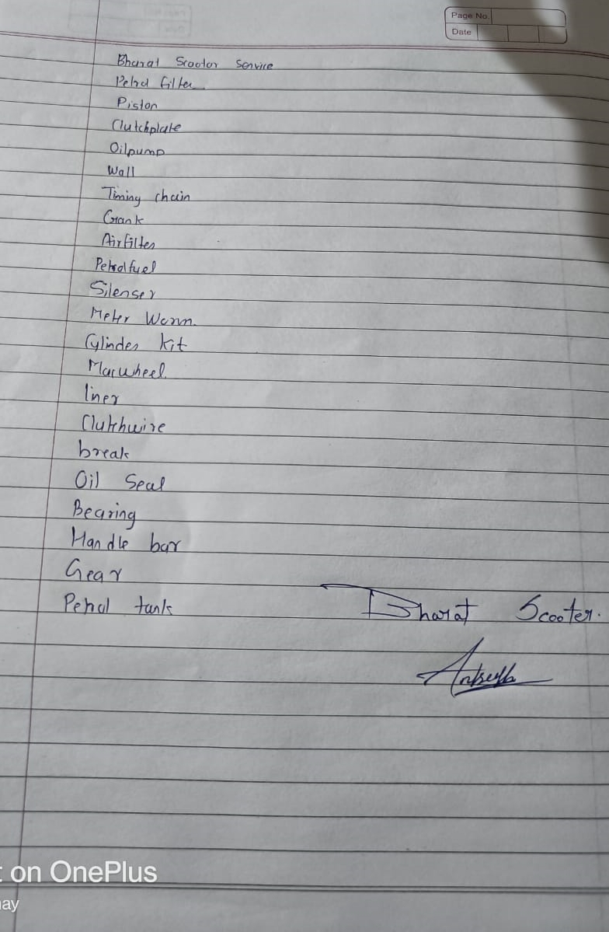

Slide 14
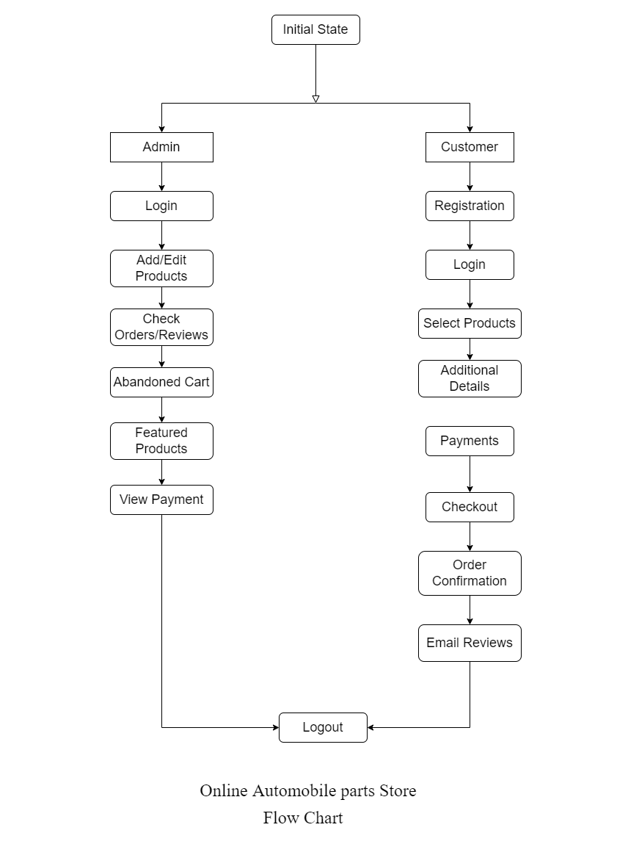
System Design: Flowchart
S. B. Jain Institute of Technology Management and research
14

Slide 15
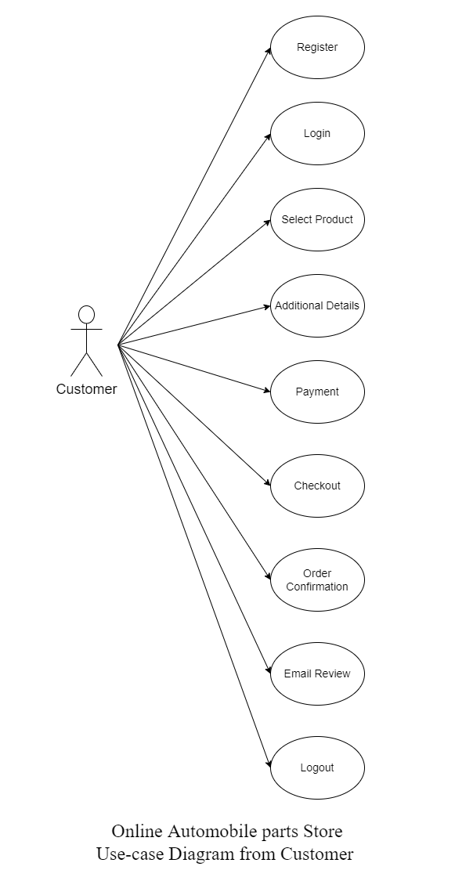
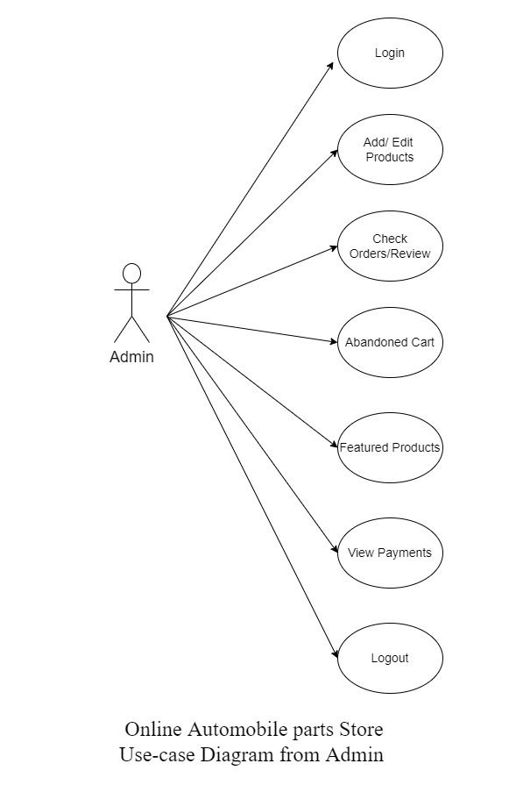
Use Case Diagram

Slide 16
Proposed Work
Module name :– Vintage Autoparts(VAp) –Antique Automobile parts store
Online Hardware Accessories Store is a web development project in which you can visit to over site to purchase various accessories required to you, buy this site it will be easy to get parts of various hardware
S. B. Jain Institute of Technology Management and Research
16

Slide 17
The Modules used in the project are
Admin
2. Customer
Admin:
Admin will login into the application with the default username and password.
Admin can add and edit the products and product details.
Admin can also view the orders placed by customers and reviews by customers. Admin can also view the abandoned cart products and featured products.
Admin can also view the payments.
Customer:
The customer can view the application by registering or without registering as a guest user.
But the guest user has limited functionalities compared to the registered user.
Registered customer must log in with the username and password after logging in User can select the products and add them to the cart.
After the product is selected customer needs to provide some additional details like shipping address after that the payment will be initiated by the customer, after successful payment the customers will get emails listed as Order copy, Delivery Details Copy and Thanks Copy.

Slide 18
Existing System:
In the Existing system,
Customer are experiencing the people suffering to find parts in shop and at last they get nothing in there hand this takes lot of time.
Visiting to shop but not finding a appropriate parts and at last satisfying with adjustment.
Proposed System:
In Proposed System ,
the admin will maintain a wide range of products at affordable prices for customers and it makes easier for those who buy in the application.
If a customer leaves the product in the cart without buying and exits the application then the customer will get the mail after particular time.

Slide 19
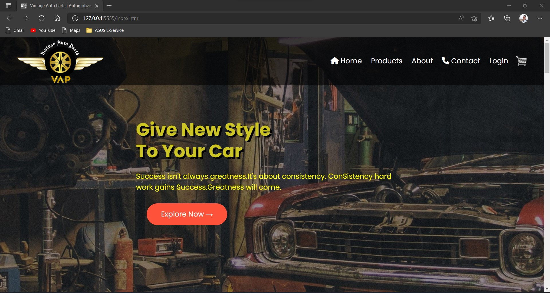
Screenshots

Slide 20
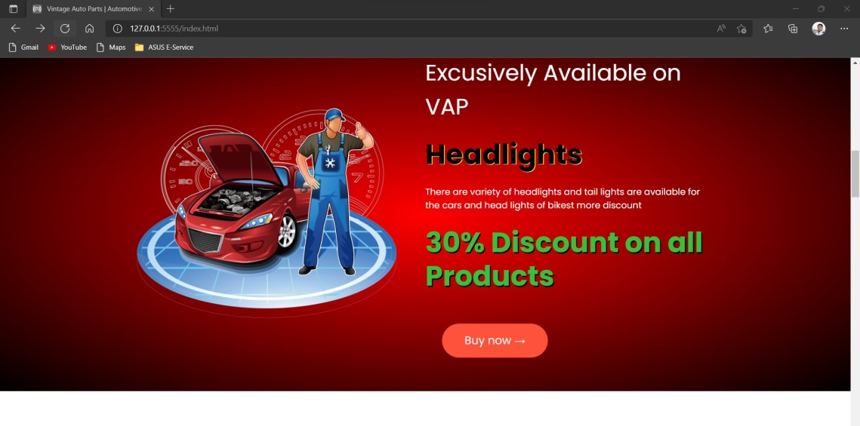
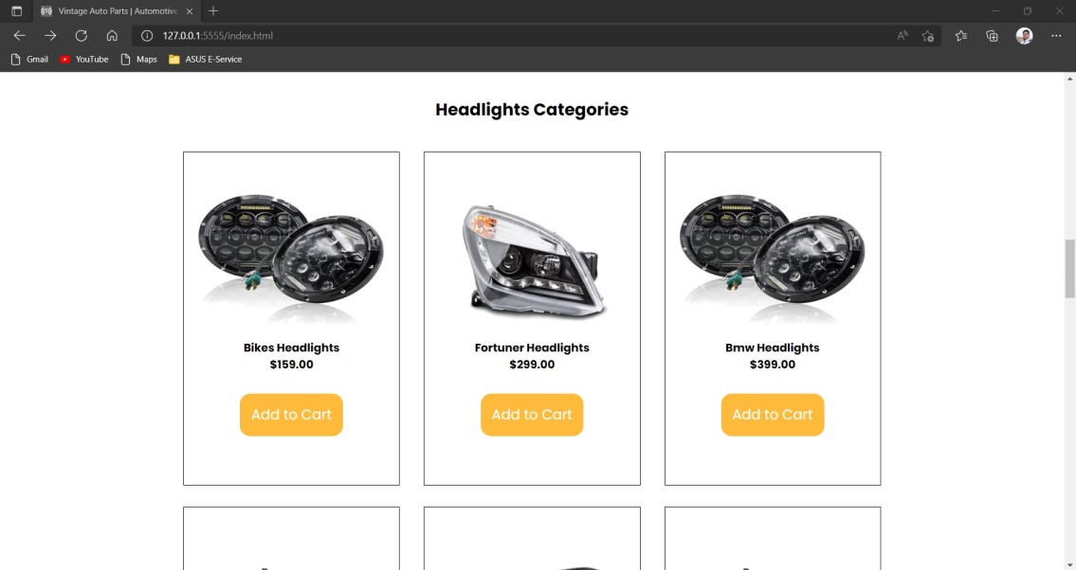
Screenshots

Slide 21
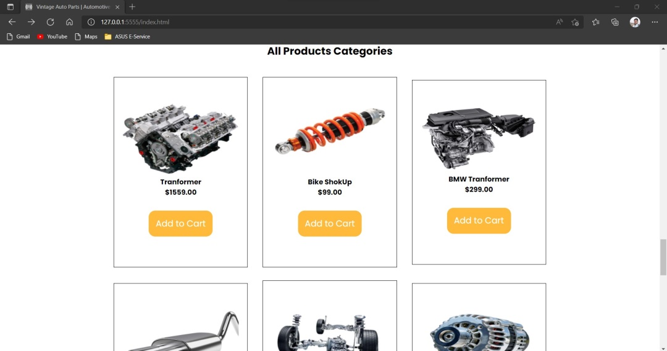
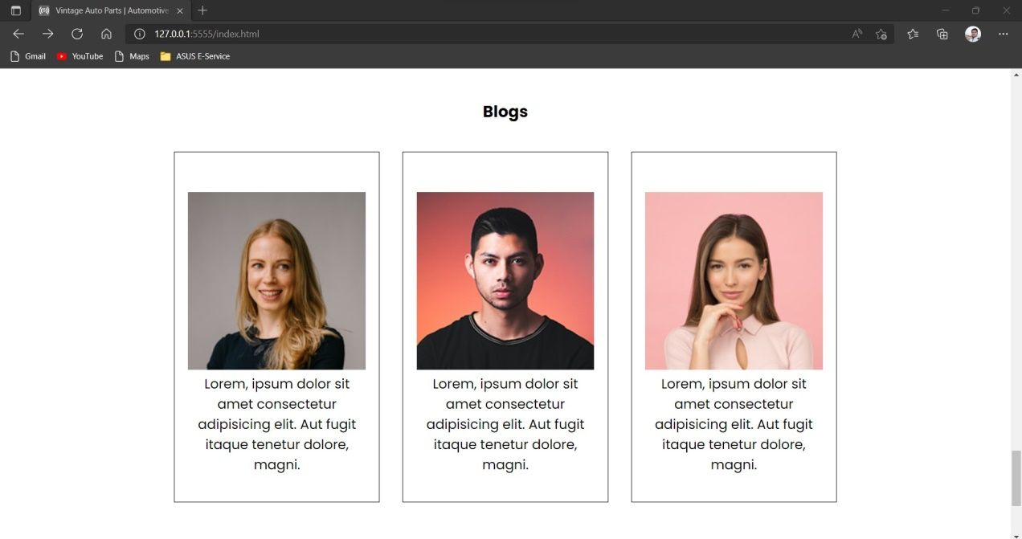
Screenshots

Slide 22
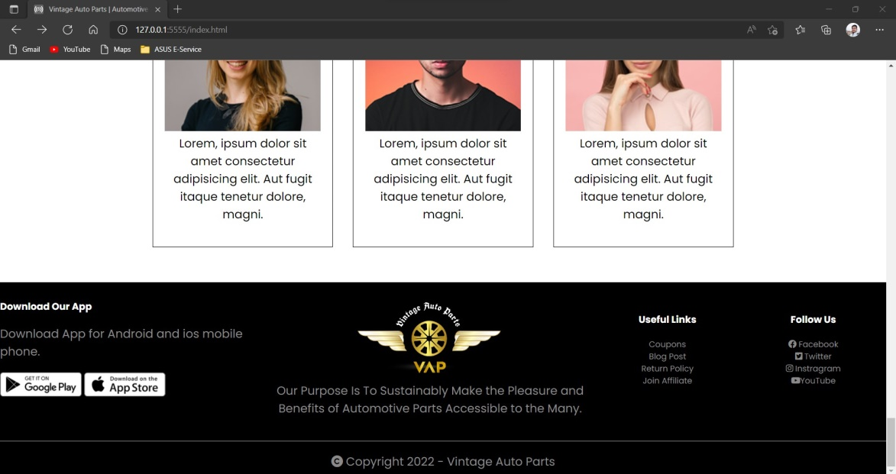
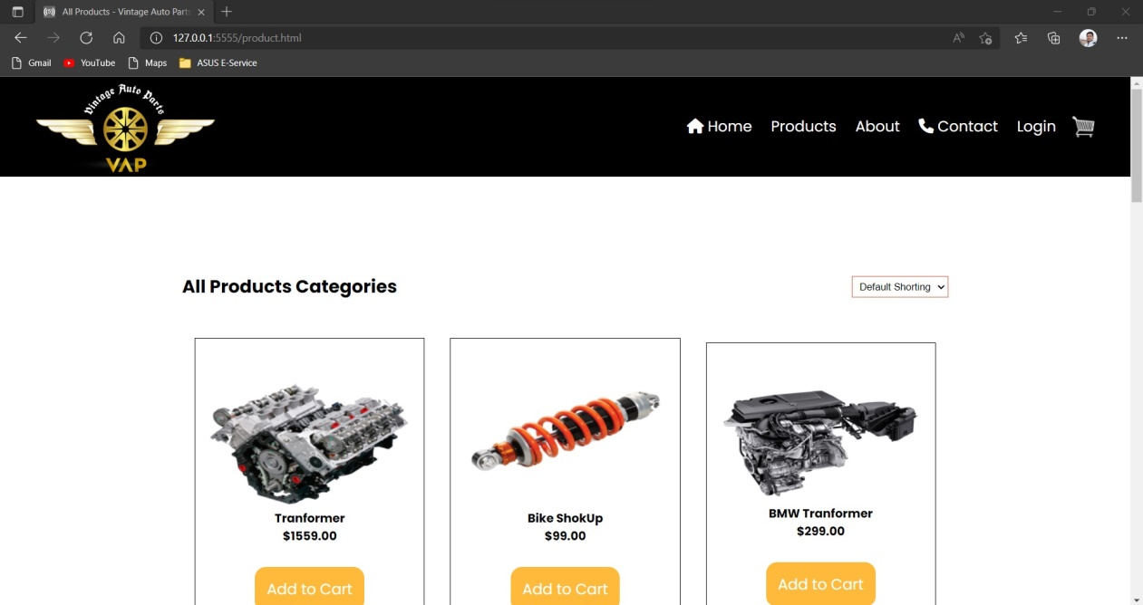
Screenshots

Slide 23
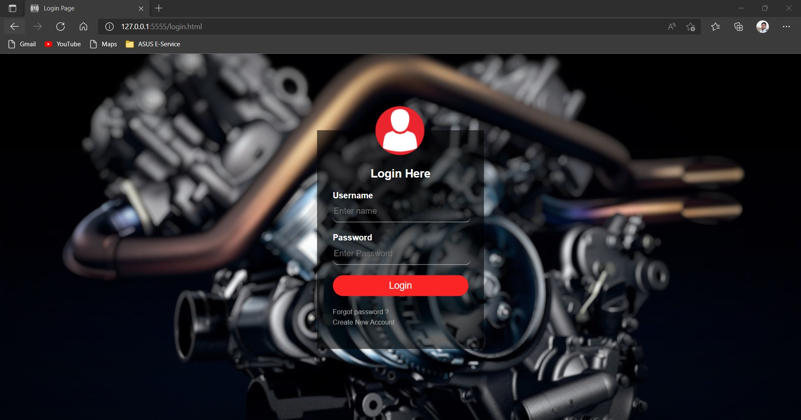
Screenshots

Slide 24
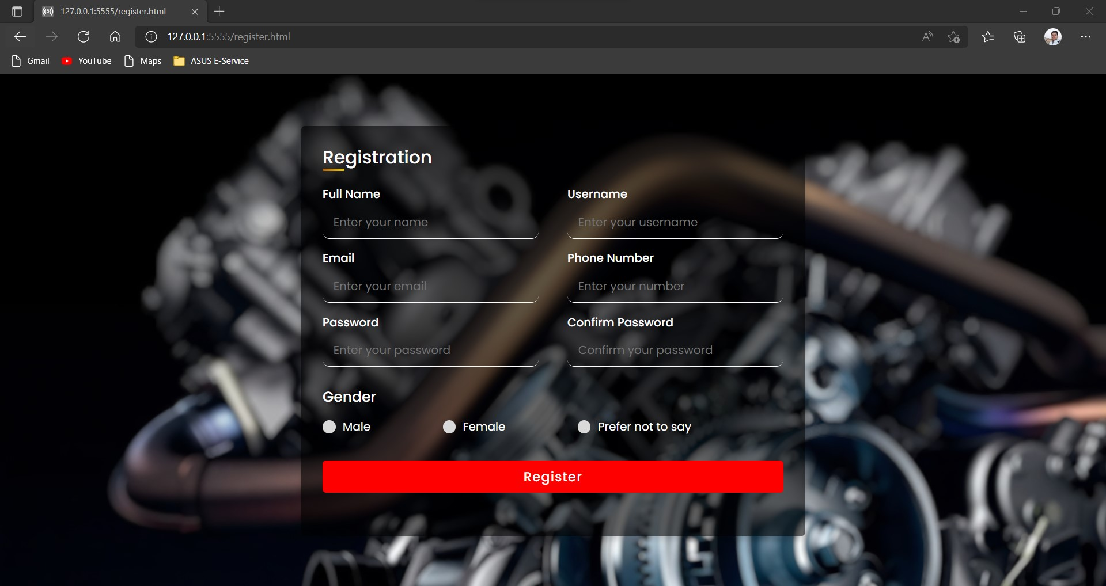
Screenshots

Slide 25
Technology to be Use
Front End:
JavaScript : - Java script is used for client side scripting which can help in using validation on the
website and many more other functions.
CSS : - CSS is cascading style sheet which is used to give designer look to HTML using the
HTML : - It is used for giving eye catching look to the website. And also providing easy to use
Back End:
PHP, MySQL, Firebase
Library/API/Framework:
React JS
Hardware used:
Desktop(Computer , Laptop)
S. B. Jain Institute of Technology Management and research
25

Slide 26
Advantages & Applications
Advantages:
By this website Customer will be able to get items easily .
Customer does not need find parts at shops because it will be available at the website.
Also ,Shipment of the part will be at there designated location.
Application:
As per the survey , the major customer are the shopkeepers, because of lack of parts .
Which will help them to easily restore parts from website.
As well as, customer who needs parts for there vehicle(local customers).
Some customers needs part to customize there vehicles.
S. B. Jain Institute of Technology Management and Research
26

Slide 27
Plan of Work
Work | Time (Days) | Status
Requirement Gathering (Project) | 1 Day | Done
Analysis (Project) | Half Day | Done
Requirement gathering & Analysis (Module1) | 2-3 Days | Done
Implementation (Module1) | 10-12 Days | Done
Testing (Module1) | 1-2 Days | Done
Requirement gathering & Analysis(Module2) | 4-5 Days | In Process
Implementation (Module2)
Testing (Module2)
Report Generation &Submission |  | After Successful completion of above modules
Requirement gathering & Analysis(Module3)
Implementation (Module3)
Testing (Module3)
Report Generation &Submission |  | After Successful completion of above modules
S. B. Jain Institute of Technology Management and Research
27

Slide 28
References
Online Articles:
https://www.bigcommerce.com/articles/ecommerce/selling-auto-parts-online/
https://www.bytestechnolab.com/blog/building-an-online-auto-parts-store-an-overview-of-essential-features/
Websites:
www.mouthshut.com
www.gomechanic.in
Real-time Survey from Shops:
Bombay Scooter agency -
location – Yashwant stadium ,Sitaburdi, Nagpur
Karan enterprises
location – Katol Naka , Nagpur
S. B. Jain Institute of Technology Management and Research
28

Slide 29
Thank You

